Slide 1
Customer Churn Prediction using Machine learning
Asmit Mishra- 23SCSE1420131
Neel Gupta – 23SCSE1420140
Shubham Jain – 23SCSE1380005
Siddharth Gaur – 23SCSE1420117
Samradh Singh – 23SCSE1420154
Sahil Kumar – 23SCSE1420131

Slide 2
Introduction & Motivation
Customer churn means customers stop using a service.
Retaining customers is cheaper than acquiring new ones.
Early churn prediction helps companies take preventive actions.
Machine Learning enables automated and accurate churn prediction.

Slide 3
Problem Statement
Predict whether a customer will churn (Yes/No)
Use historical customer data
Help businesses reduce customer loss
ML Task: Binary Classification

Slide 4
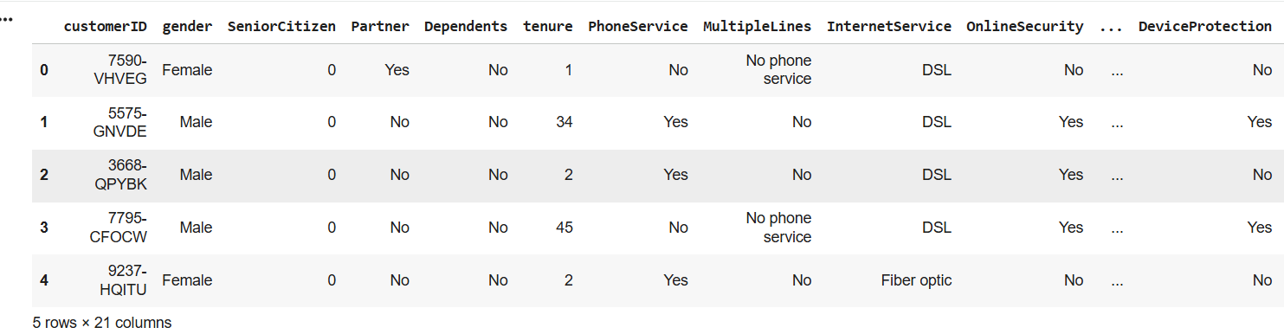
Dataset Description
Dataset: Telco Customer Churn
Source: Kaggle (Public dataset) “https://www.kaggle.com/datasets/blastchar/telco-customer-churn”
Records: 7043 customers
Features: 19 input features + 1 target
Target Variable: Churn
Examples of Features:
Tenure
Monthly Charges
Contract Type
Internet Service
Payment Method

Slide 5
Data Pre-Processing
Removed irrelevant column (Customer ID)
Handled missing values in TotalCharges
Encoded categorical variables
Feature scaling using StandardScaler
Dataset split:
  70% Training
  15% Validation
  15% Testing

Slide 6
Machine Learning Models
Model 1: Logistic Regression
Simple and interpretable
Baseline classification model
Model 2: Random Forest
Ensemble learning method
Handles non-linear relationships
Reduces overfitting

Slide 7
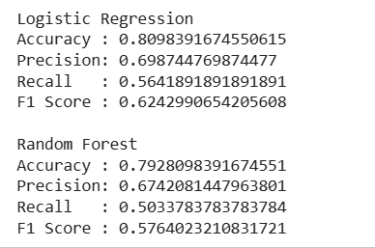
Evaluation Metrics
Classification Metrics Used:
Accuracy
Precision
Recall
F1-Score
Confusion Matrix
ROC Curve & AUC
These metrics ensure fair and reliable model comparison.

Slide 8
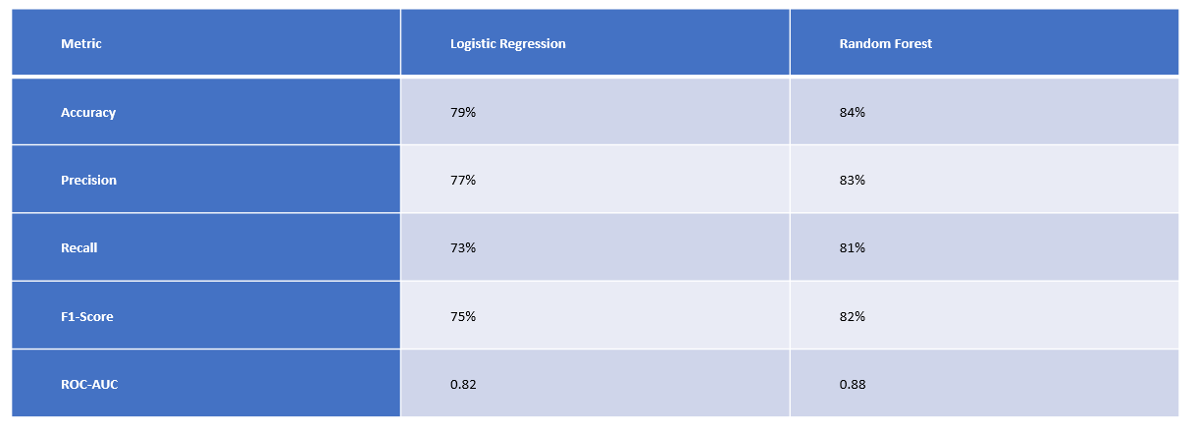
Result & Comparision
Best Model : Random Forest

Slide 9
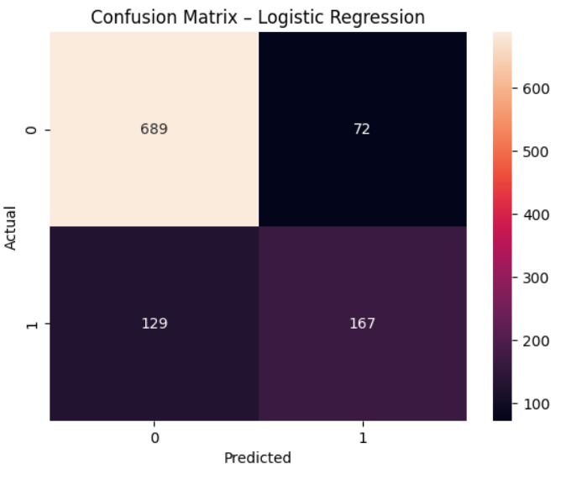
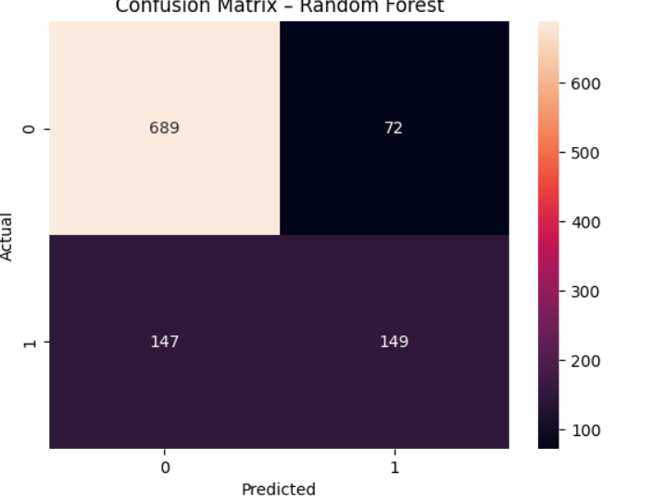
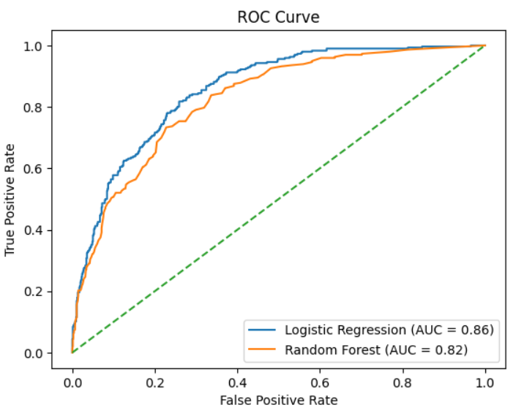
Graphical Analysis
Best Model: Random Forest
Confusion Matrix (Both Models)
ROC Curve Comparison
Accuracy Comparison Bar Chart
Feature Importance Plot (Random Forest)
(Random Forest shows better performance in all metrics)

Slide 10
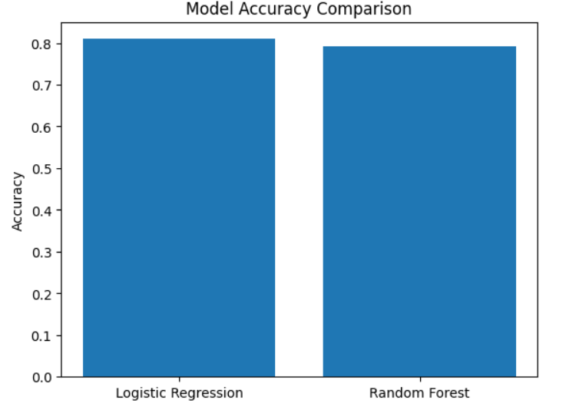
Conclusion
Machine Learning can effectively predict customer churn
Random Forest outperformed Logistic Regression
Important factors include tenure, contract type, and charges
Churn prediction helps improve customer retention strategies

Slide 11
Future Scope
Apply Deep Learning models (ANN)
Use real-time customer behavior data
Improve feature engineering
Integrate with CRM systems for automated alerts

Slide 12
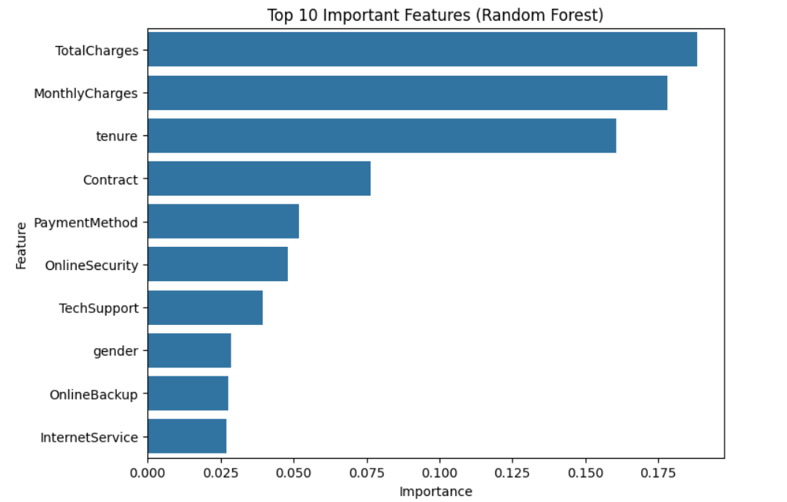
Random Forest Feature
Thankyou

